Slide 1


A first step towards the implementation and software-to-software validation of an active distribution network model
Aboutaleb Haddadi*, Hossein Hooshyar†, Jean Mahseredjian*, Christian Dufour‡, and Luigi Vanfretti†
* Montreal Polytechnic, Canada
† KTH Royal Institute of Technology, Sweden
‡Opal-RT Technologies, Montreal, Canada
June 2017
A. Haddadi, "A First Step Towards the Implementation and Software-to-Software Validation of an Active Distribution Network Model"

Slide 2
Outline
Motivation
The model of the Active Distribution Network (ADN)
Different implementations
  EMTP-RV
  State-Space Nodal (SSN) method
Software-to-software validation of the AND through comparison of the simulation results of EMTP-RV and SSN
  Power-flow solution
  Steady-state solution
  Time-domain simulations
Discussion and future work
A. Haddadi, "A First Step Towards the Implementation and Software-to-Software Validation of an Active Distribution Network Model"

Slide 3
Motivation
Test power systems for simulation studies of active distribution grids (ADN) are rare.
Existing test cases in the literature do not adequately represent the complex dynamics of an ADN (single voltage level, lack of components such as Distributed Energy Resources (DER) and protection systems).
This paper presents an ADN model developed for control, protection, and dynamic studies of active distribution grids integrating DER.
The paper presents two implementations of the ADN in two different software environments: EMTP-RV (off-line simulations) and MATLAB/Simulink/Opal-RT (SSN implementation for real-time simulations).
Simulation of the ADN with different tools provides software-to-software verification for the establishment of the model as a potential benchmark.
The model can be used by other researchers for testing numerical methods and conducting research on smart grid control, protection, and dynamic studies.
A. Haddadi, "A First Step Towards the Implementation and Software-to-Software Validation of an Active Distribution Network Model"

Slide 4
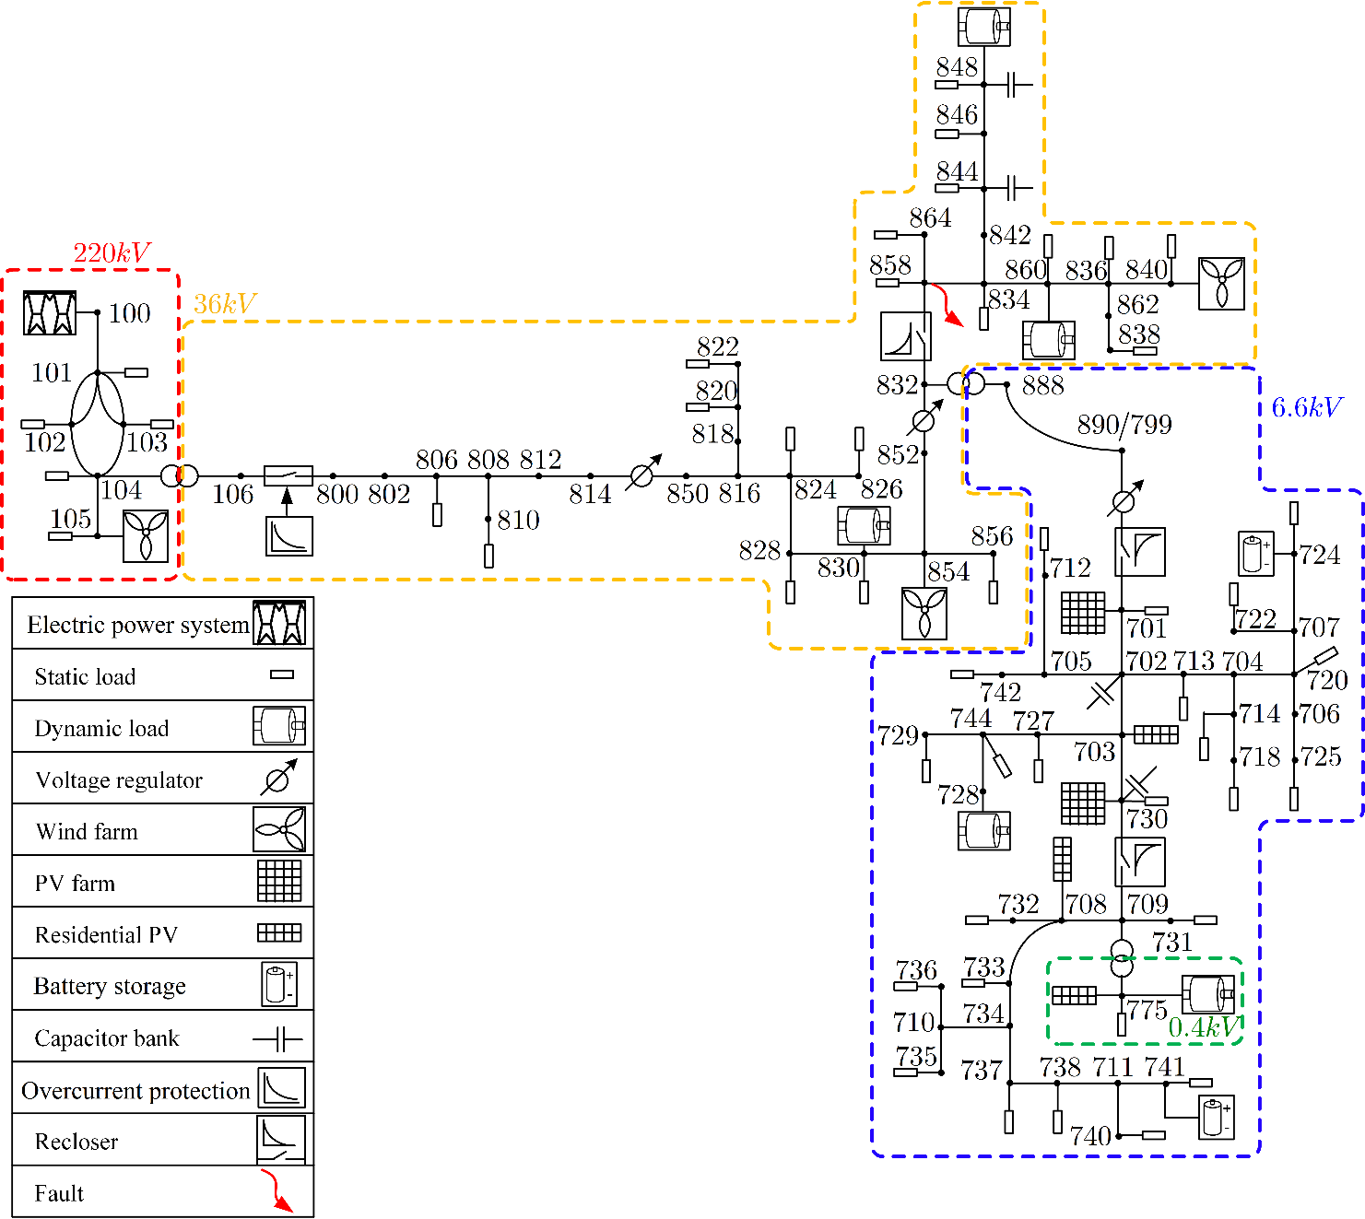
The ADN
Different voltage levels:
  220-kV transmission grid (HV),
  36-kV medium-voltage (MV),
  6.6-kV low-voltage (LV), and
  0.4-kV residential LV grid.
The ADN consists of MV, LV, and residential LV grids.
Total generation is 200MW, and the overall load 191MW.
The generation and load of the ADN represent total DER generation of 5MW and load of 4.1MW+j1.9MVar (can be operated as a microgrid).
The DERs includes wind (53MW), solar (1.8MW), and storage (0.15MW). Their model include power electronic interface, control, protection.
Three-phase and single-phase static loads and motor loads.
The ADN model also includes voltage, current, and frequency protection schemes for DER units, feeders, and loads.

Slide 5
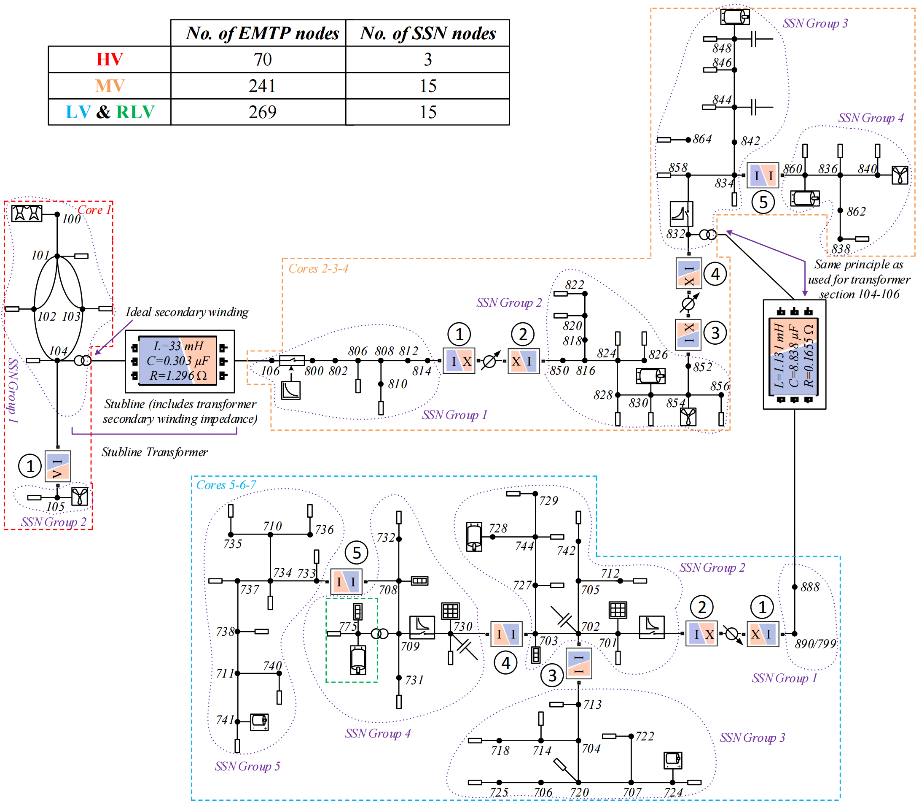
SSN Implementation[1]
Using State-Space-Nodal method.
The model is split into 11 SSN groups which are solved in parallel using a threaded process.
Can be used for real-time simulations.
[1] H. Hooshyar, L. Vanfretti, C. Dufour, “Delay-free parallelization for real-time simulation of a large active distribution grid model,” in Proc. IEEE IECON, Italy, Oct. 2016.

Slide 6
EMTP-RV Implementation
Contains no artificial delay blocks (stub-line) and uses an iterative solver for nonlinear functions, thus provides additional results for simulation accuracy analysis.
For off-line simulations.
Differences between the EMTP-RV and SSN implementations:
  The method of initialization of the time-domain solver: SSN uses auxiliary voltage sources during start-up to help the grid reach a stable operating point; the EMTP-RV version initializes from an unbalanced power flow solution (no need for an artificial voltage source).
  Different control and power schemes for PV and wind generation units (same output real and reactive power in steady-state).
  The SSN version models static loads as constant-I, Z, or PQ. The EMTP-RV version models them as constant-Z (work in progress to match the load models).
Table: Model data of the EMTP-RV implementation of the ADN.
Total number of network nodes | 978
Size of the main system of equations | 1617
Number of iterations per time-point | 3.06

Slide 7
Comparison of the Results of EMTP-RV and SSN Implementations
In theory, the SSN and EMTP-RV solvers are expected to give exactly the same solution.
Any differences in simulation results are due to modeling differences.
Three sets of simulation results have been presented:
  Power-flow solution (comparison not available due to the use of artificial ideal voltage sources in the SSN version used for initialization)
  Steady-state solution
  Time-domain solution
A. Haddadi, "A First Step Towards the Implementation and Software-to-Software Validation of an Active Distribution Network Model"

Slide 8
Power-flow Solution (EMTP-RV)
Bus | Phase a |  | Phase b |  | Phase c |  | Bus | Phase a |  | Phase b |  | Phase c
 | V (pu) | Phase angle (deg) | V (pu) | Phase angle (deg) | V (pu) | Phase angle (deg) |  | V (pu) | Phase angle (deg) | V (pu) | Phase angle (deg) | V (pu) | Phase angle (deg)
100 | 1.02 | -1.9 | 1.02 | -121.9 | 1.02 | 118.1 | 741 | 0.97 | 16.2 | 0.97 | -103.7 | 0.97 | 136.2
101 | 0.99 | -10.5 | 0.99 | 130.5 | 0.99 | 109.5 | 742 | 0.98 | 16.1 | 0.98 | -103.8 | 0.97 | 136.3
102 | 0.99 | -11.8 | 0.99 | -131.8 | 0.99 | 108.2 | 744 | 0.98 | 16.2 | 0.98 | -103.8 | 0.98 | 136.3
103 | 0.99 | -12.1 | 0.99 | -132.1 | 0.99 | 108.0 | 775 | 0.98 | 16.3 | 0.98 | -103.8 | 0.98 | 136.2
104 | 0.99 | -12 | 0.99 | -132.0 | 0.99 | 108.0 | 800 | 0.98 | 16.8 | 0.98 | -103.1 | 0.99 | 137.1
105 | 1.00 | -10.5 | 1.00 | -130.5 | 1.00 | 109.5 | 802 | 0.98 | 16.8 | 0.98 | -103.1 | 0.99 | 137.1
106 | 0.98 | 16.8 | 0.98 | -103.1 | 0.99 | 137.1 | 806 | 0.98 | 16.8 | 0.98 | -103.1 | 0.99 | 137.1
701 | 0.98 | 16.2 | 0.98 | -103.8 | 0.98 | 136.2 | 808 | 0.97 | 16.6 | 0.98 | -103.3 | 0.99 | 136.9
702 | 0.98 | 16.2 | 0.98 | -103.8 | 0.98 | 136.2 | 810 | n.a. | n.a. | 0.98 | -103.3 | n.a. | n.a.
703 | 0.98 | 16.2 | 0.98 | -103.8 | 0.98 | 136.3 | 812 | 0.96 | 16.4 | 0.97 | -103.6 | 0.98 | 136.8
704 | 0.98 | 16.1 | 0.98 | -103.8 | 0.97 | 136.2 | 814 | 0.95 | 16.2 | 0.97 | -103.8 | 0.98 | 136.6
705 | 0.98 | 16.1 | 0.98 | -103.8 | 0.97 | 136.2 | 816 | 0.99 | 16.2 | 1.00 | -103.8 | 1.01 | 136.6
706 | 0.98 | 16.2 | 0.98 | -103.8 | 0.97 | 136.2 | 818 | 0.99 | 16.2 | n.a. | n.a. | n.a. | n.a.
707 | 0.98 | 16.2 | 0.97 | -103.8 | 0.97 | 136.3 | 820 | 0.99 | 16.2 | n.a. | n.a. | n.a. | n.a.
708 | 0.98 | 16.3 | 0.98 | -103.8 | 0.97 | 136.2 | 822 | 0.99 | 16.2 | n.a. | n.a. | n.a. | n.a.
709 | 0.98 | 16.3 | 0.98 | -103.8 | 0.98 | 136.2 | 824 | 0.99 | 16.2 | 1.00 | -103.8 | 1.00 | 136.5
710 | 0.97 | 16.2 | 0.97 | -103.7 | 0.97 | 136.3 | 826 | n.a. | n.a. | 1.00 | -103.8 | n.a. | n.a.
711 | 0.97 | 16.2 | 0.97 | -103.8 | 0.97 | 136.2 | 828 | 0.99 | 16.2 | 1.00 | -103.8 | 1.00 | 136.5
712 | 0.98 | 16.1 | 0.98 | -103.8 | 0.97 | 136.2 | 830 | 0.98 | 16.1 | 0.99 | -103.9 | 1.00 | 136.4
713 | 0.98 | 16.1 | 0.98 | -103.8 | 0.97 | 136.2 | 832 | 1.00 | 16.1 | 1.01 | -104.0 | 1.01 | 136.1
714 | 0.98 | 16.1 | 0.98 | -103.8 | 0.97 | 136.2 | 834 | 1.00 | 16.0 | 1.01 | -104.1 | 1.01 | 135.9
718 | 0.98 | 16.1 | 0.98 | -103.8 | 0.97 | 136.2 | 836 | 1.00 | 16.0 | 1.01 | -104.1 | 1.01 | 135.9
720 | 0.98 | 16.1 | 0.98 | -103.8 | 0.97 | 136.2 | 838 | n.a. | n.a. | 1.01 | -104.1 | n.a. | n.a.
722 | 0.97 | 16.2 | 0.97 | -103.9 | 0.97 | 136.4 | 840 | 1.00 | 16.0 | 1.01 | -104.1 | 1.01 | 135.9
724 | 0.97 | 16.3 | 0.97 | -103.8 | 0.97 | 136.2 | 842 | 1.00 | 16.0 | 1.01 | -104.1 | 1.01 | 135.9
725 | 0.98 | 16.2 | 0.98 | -103.8 | 0.97 | 136.2 | 844 | 1.00 | 16.0 | 1.01 | -104.1 | 1.01 | 135.9
727 | 0.98 | 16.2 | 0.98 | -103.8 | 0.98 | 136.3 | 846 | 1.00 | 16.0 | 1.01 | -104.2 | 1.01 | 135.9
728 | 0.98 | 16.2 | 0.98 | -103.8 | 0.98 | 136.3 | 848 | 1.00 | 16.0 | 1.01 | -104.2 | 1.01 | 135.9
729 | 0.98 | 16.2 | 0.98 | -103.8 | 0.98 | 136.3 | 850 | 0.99 | 16.2 | 1.00 | -103.8 | 1.01 | 136.6
730 | 0.98 | 16.2 | 0.98 | -103.8 | 0.98 | 136.3 | 852 | 0.97 | 16.1 | 0.98 | -104.0 | 0.98 | 136.1
732 | 0.98 | 16.3 | 0.98 | -103.8 | 0.97 | 136.2 | 854 | 0.98 | 16.1 | 0.99 | -103.9 | 1.00 | 136.4
733 | 0.97 | 16.3 | 0.97 | -103.8 | 0.97 | 136.2 | 856 | n.a. | n.a. | 0.99 | -103.9 | n.a. | n.a.
734 | 0.97 | 16.2 | 0.97 | -103.8 | 0.97 | 136.3 | 858 | 1.00 | 16.1 | 1.01 | -104.1 | 1.01 | 136.0
735 | 0.97 | 16.2 | 0.97 | -103.7 | 0.97 | 136.3 | 860 | 1.00 | 16 | 1.01 | -104.1 | 1.01 | 135.9
736 | 0.97 | 16.3 | 0.97 | -103.7 | 0.97 | 136.2 | 862 | 1.00 | 16 | 1.01 | -104.1 | 1.01 | 135.9
737 | 0.97 | 16.2 | 0.97 | -103.7 | 0.97 | 136.3 | 864 | 1 | 16.1 | n.a. | n.a. | n.a. | n.a.
738 | 0.97 | 16.2 | 0.97 | -103.8 | 0.97 | 136.3 | 888 | 1.00 | 16 | 1.01 | -104.1 | 1.01 | 135.9
740 | 0.97 | 16.2 | 0.97 | -103.7 | 0.97 | 136.2 | 890/799 | 0.95 | 16.2 | 0.95 | -103.8 | 0.95 | 136.2
A. Haddadi, "A First Step Towards the Implementation and Software-to-Software Validation of an Active Distribution Network Model"

Slide 9
Steady-state Solution
Table: Steady-state voltage of selected buses of the ADN in EMTP-RV vs. SSN: V in pu, θ in degrees.
Bus | Quantity | EMTP-RV | SSN
852 | V_{a} | 1.03 | 1.03
 | θ_{a} | 21.0 | 22.0
 | V_{b} | 1.03 | 1.03
 | θ_{b} | -99.0 | -98.0
 | V_{c} | 1.03 | 1.03
 | θ_{c} | 141.0 | 142.0
799 | V_{a} | 1.02 | 1.02
 | θ_{a} | 18.0 | 20.0
 | V_{b} | 1.02 | 1.02
 | θ_{b} | -102.0 | -100.0
 | V_{c} | 1.02 | 1.02
 | θ_{c} | 138.0 | 140.0
730 | V_{a} | 1.01 | 1.01
 | θ_{a} | 18.0 | 20.0
 | V_{b} | 1.01 | 1.02
 | θ_{b} | -102.0 | -100.0
 | V_{c} | 1.01 | 1.01
 | θ_{c} | 138.0 | 140.0
The simulation is run for a sufficiently long time until the network reaches a steady-state condition.
Voltage amplitudes match closely.
Phase angles exhibit a slight difference which is primarily due to different static load models used in the two versions (constant-Z in EMTP-RV vs constant Z/I/PQ in SSN).
As a future work, this difference can be further reduced by matching the static loads models.

Slide 10
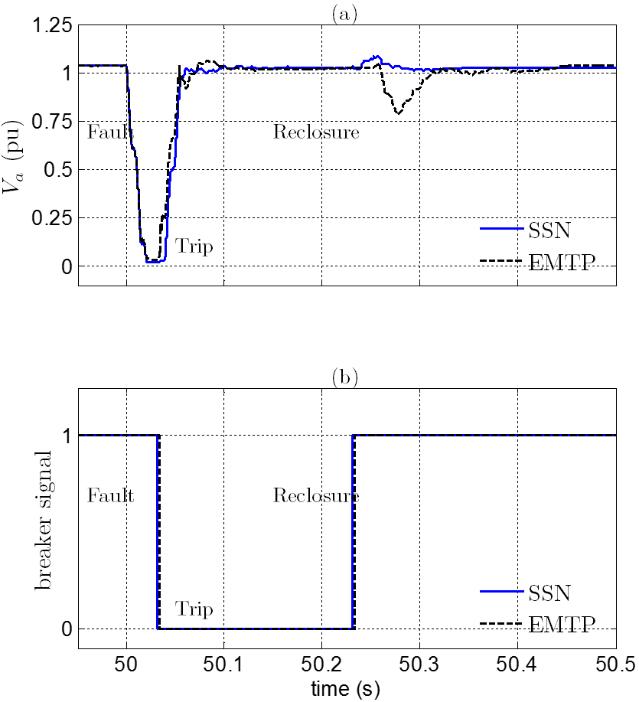
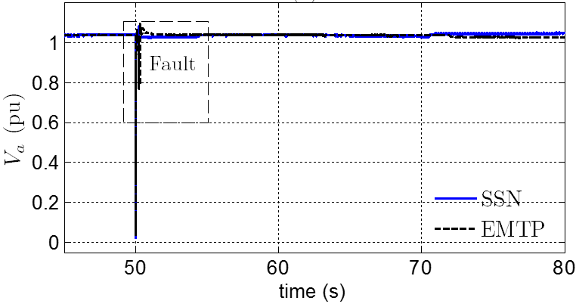
Time-domain Simulations
A 6-cycle three-phase bolted fault is applied on the MV feeder at bus 858 at t = 50s. Subsequently, the three-phase MV recloser at the feeder section 832-858 detects and isolates the fault within 2 cycles.
Figure: Voltage (phase ‘a’) of bus 832 of the MV section in response to a three-phase bolted fault on bus 858 at t = 50 s obtained from the SSN, and the EMTP-RV model.
Figure: Zoomed view of voltage (phase ‘a’) of bus 832 of the MV section in response to a three-phase bolted fault on bus 858 at t = 50 s obtained from the SSN, and the EMTP-RV model.
A. Haddadi, "A First Step Towards the Implementation and Software-to-Software Validation of an Active Distribution Network Model"

Slide 11
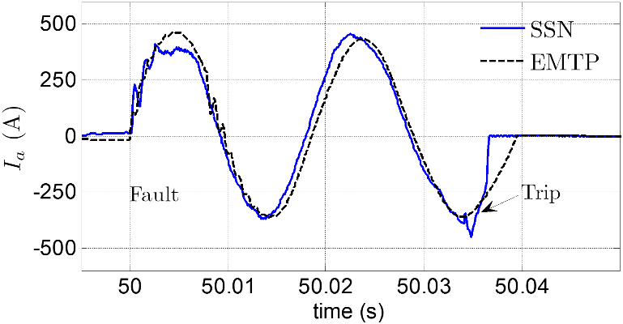
Time-domain Simulations
Figure: The breaker signal of the MV recloser at the feeder section 832-858; trip signal issued at 50.033s in the EMTP-RV and the SSN models; the reclosing time is at 50.2332 s in EMTP-RV and 50.2331 s in SSN.
Figure: Fault current (phase ‘a’) for a three-phase bolted fault at t=50 s on bus 858 obtained from the SSN and the EMTP-RV model.
A. Haddadi, "A First Step Towards the Implementation and Software-to-Software Validation of an Active Distribution Network Model"

Slide 12
Analysis of the Inconsistent Results
Inconsistencies in time-domain results are primarily due to differences in DER models (different control parameters and additional active filter and choke circuit elements in the DFIG and PV models used in the EMTP implementation) which result in a different transient behavior. As a future work, the control of DER units is to be adjusted to make the time-domain results of the two versions more consistent.
Fault currents exhibit some differences in the first cycle in terms of peak instantaneous current and the amplitude and frequency of high-frequency oscillations. These differences stem predominately from the difference in control parameters of DER units as their time-scale of milliseconds corresponds to the time-constant of the control scheme of the DER units. Furthermore, the current waveforms exhibit a phase difference which is most likely due to the difference in the time-constant of the real- and reactive-power control scheme of the DER units. The current waveform of the SSN implementation exhibits a nonlinear behavior due to nonlinear load models used in the SSN implementation.
A. Haddadi, "A First Step Towards the Implementation and Software-to-Software Validation of an Active Distribution Network Model"

Slide 13
Conclusion and Discussion
Two implementations of an active distribution test case have been presented, and their simulation results have been compared to provide software-to-software validation of the test case.
Simulation results agree largely, however, they also exhibit some differences due to modeling inconsistencies.
These differences stem from the differences in static load models and model of PV and wind generators; they can be further reduced by improving the consistency of the two models.
Discussion: It is a challenging task to obtain a perfect match between the two models given the complexity of the model and the large number of components used in the model. References [1,2] have shown that achieving perfectly matching results is a challenge in a network with much less components even when the two models share the same control equations in a source code. The main objective of this paper is to highlight this challenge and identify the reason for these inconsistencies.
[1] R. Rogersten, L. Vanfretti, W. Li, L. Zhang, and P. Mitra, “A quantitative method for the assessment of VSC-HVdc controller simulations in EMT tools,” in Innovative Smart Grid Technologies Cotiference Europe (ISGT-Europe), 2014 1EEE PES, vol. 1, no. 5, pp. 12-15, Oct. 2014.
[2] R. Rogersten, L. Vanfretti, and W. Li, “Towards consistent model exchange and simulation of VSC-HVdc controls for EMT studies,” in IEEE ISGT 2015, Washington DC, USA, 2015.

Slide 14
Questions?
aboutaleb.haddadi@polymtl.ca
A. Haddadi, "A First Step Towards the Implementation and Software-to-Software Validation of an Active Distribution Network Model"

